Slide 1
Boosting Techniques

Slide 2
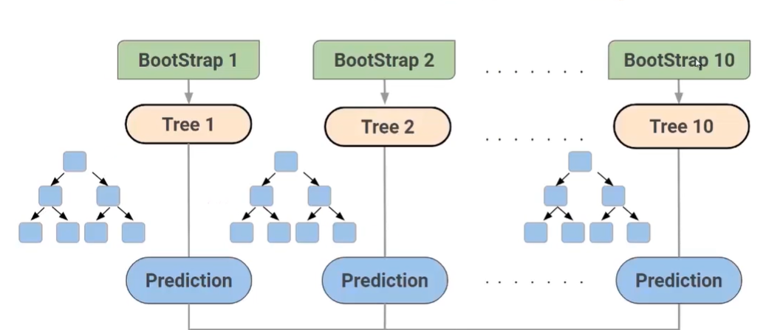
Random forest recap
Final Output

Slide 3

Random forest
Uses Bagging Techniques
Combine multiple trees
Each tree build on Different subset of data
Reduces overfitting

Slide 4
Random forest
Independent trees
Does not take into account the incorrect predictions.
New trees do not learn from the previous models

Slide 5
Boosting
Models are dependent
Correct the errors of previous models
Build sequentially

Slide 6
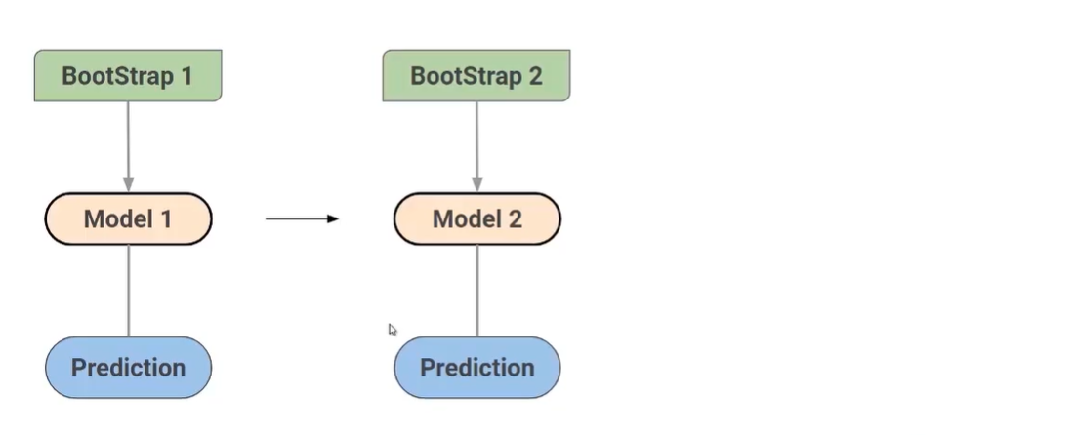
Boosting

Slide 7
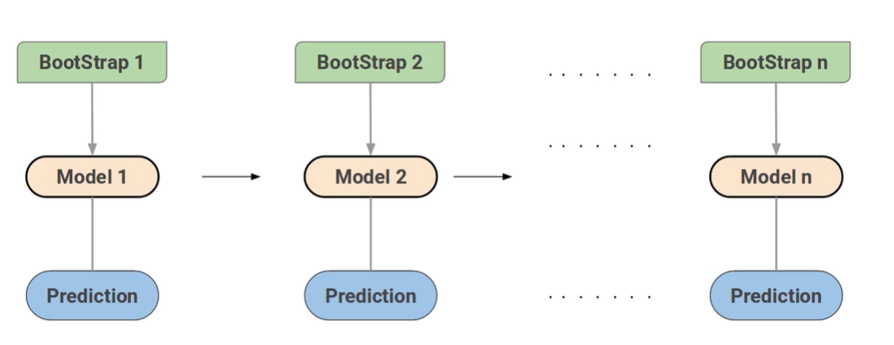
Boosting

Slide 8

Stopping Criteria for Boosting
Till the errors become zero
There is a constraint on number of model

Slide 9
Boosting
Trees are built sequentially such that each subsequent tree to aim to reduce the errors of the previous tree.
Each tree learns from its predecessors and update the residual errors.
The tree that grows next in the sequence will learn from an updated version of the residuals .
Each of these individual models are called as “Weak learners”

Slide 10
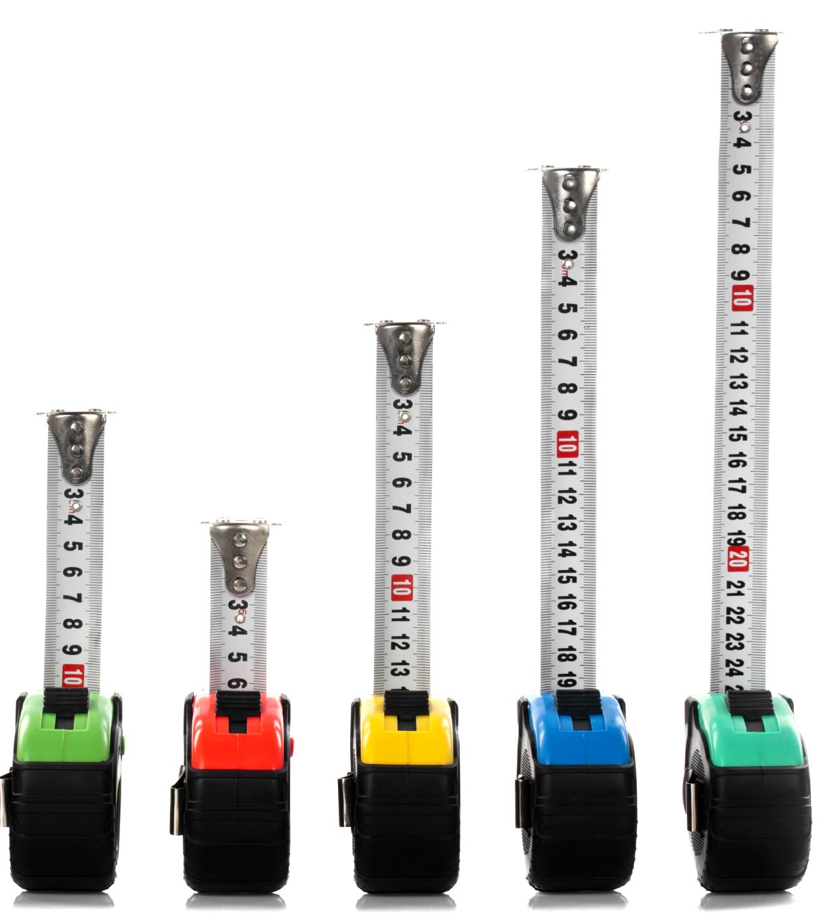
Boosting
Various boosting techniques:
AdaBoost
Gradient Boosting machine(GBM)
XGBoost
CatBoost
LightGBM

Slide 11
XGBoost
Majorly helps to reduce overfitting and improves overall performance.
Another name called “regualized boosting” techniques
Regularization:
Standard GBM implementation has no regularization like XGBoost
Parallel Processing:
1. implement parallel processing and is faster than other algoritham
2. support on Hadoop
Handling missing values:
in built routine to handle missing values

Slide 12
XGBoost
Tree Pruning
Make splits up to the max_depth specified and starts pruning the tree backwards and removes splits beyond which there is no positive gain
Built-in Cross validation
Allows users to run a cross validation at each iteration of the boosting process and thus it is easy to get the exact optimum number of boosting iteration in a single run

Slide 13

Xgboost practical

Slide 14
Catboost
Open source machine learning algorithm from Yandex
Catboost name comes from two words “Category” and “Boosting”.
Can work with the categorical variables and does not require any preprocessing for the same.
Performance
2. Handling categorical features automatically
3. Robust: lower chances of overfitting.
4. Easy to use

